Slide 1
DECISION TREE INDUCTION
USING FREQUENCY TABLE

Slide 2
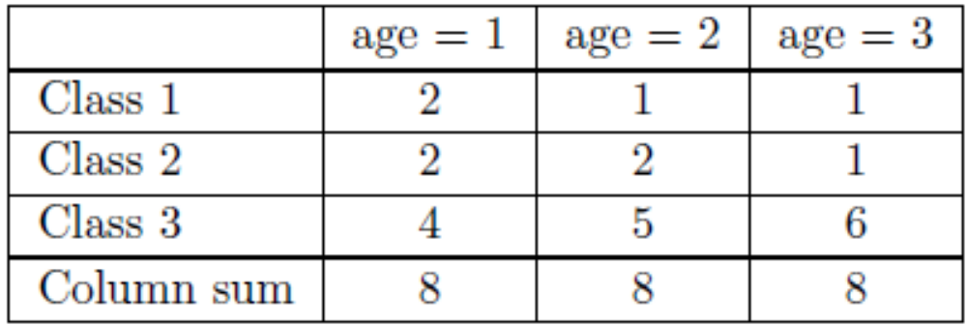
Entropy Using Frequency Table
For practical use a more efficient method is available which requires only a single table to be constructed for each categorical attribute at each node.
This method uses a frequency table. The cells of this table show the number of occurrences of each combination of class and attribute value in the training set.
For the lens24 dataset the frequency table corresponding to splitting on attribute age is shown below.

Slide 3
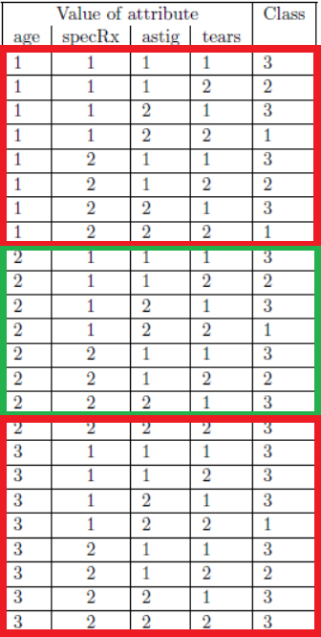
Entropy Using Frequency Table
The value of E_{new}, the average entropy of the training sets resulting from splitting on a specified attribute, can now be calculated by forming a sum as follows.
  For every non-zero value V in the main body of the table (i.e. the part above the ‘column sum’ row), subtract V × log₂ V .
  For every non-zero value S in the column sum row, add S × log₂ S.
  Finally, divide the total by total number of instances N.

Slide 4
Entropy Using Frequency Table
Total number of instances, N = 24
Using the frequency table, splitting on attribute age E_{new} is
(−2 log₂ 2 − 1 log₂ 1 − 1 log₂ 1 − 2 log₂ 2 − 2 log₂ 2 − 1 log₂ 1 −4 log₂ 4 − 5 log₂ 5 − 6 log₂ 6 + 8 log₂ 8 + 8 log₂ 8 + 8 log₂ 8)/24
= (−3 × 2 log₂ 2 − 3 log₂ 1 − 4 log₂ 4 − 5 log₂ 5 − 6 log₂ 6 + 3 × 8 log₂ 8)/24 = 1.2867 bits (to 4 decimal places)

Slide 5


Gini Index of Diversity
As well as entropy (or information gain) many other methods have been proposed for selecting the attribute.
One measure that is commonly used is the Gini Index of Diversity.
If there are K classes, with the probability of the ith class being p_{i}, the Gini Index is defined as
The value of the Gini Index for the jth subset resulting from splitting on a specified attribute is G_{j}, where

Slide 6
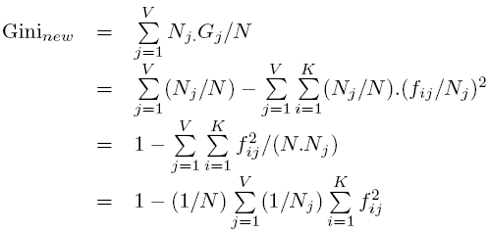
Gini Index of Diversity
The weighted average value of the Gini Index for the subsets resulting from splitting on the attribute is

Slide 7
Gini Index of Diversity
Splitting on a chosen attribute gives a reduction in the average Gini Index of the resulting subsets (as it does for entropy).
At each stage of the attribute selection process the attribute is selected which maximises the reduction in the value of the Gini Index, i.e. Gini_{start}−Gini_{new}.
Again taking the example of the lens24 dataset, the initial probabilities of the three classes are p1 = 4/24, p2 = 5/24 and p3 = 15/24.
Hence the initial value of the Gini Index is
G_{start} = 1 – ( (4/24)² + (5/24)² + (15/24)²) = 0.5382.

Slide 8
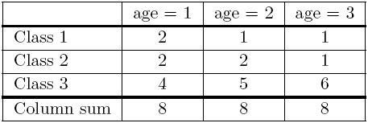

Gini Index of Diversity
We can now calculate the new value of the Gini Index as follows.
  For each non-empty column, form the sum of the squares of the values in the body of the table and divide by the column sum.
  Add the values obtained for all the columns and divide by N (the number of instances).
  Subtract the total from 1.
  G_{new} = 1− (3 + 3.75 + 4.75)/24 = 0.5208.

Slide 9
Gini Index of Diversity
Thus the reduction in the value of the Gini Index corresponding to splitting on attribute age is 0.5382 − 0.5208 = 0.0174
specRx: Gnew = 0.5278, so the reduction is 0.5382 − 0.5278 = 0.0104
astig: Gnew = 0.4653, so the reduction is 0.5382 − 0.4653 = 0.0729
tears: Gnew = 0.3264, so the reduction is 0.5382 − 0.3264 = 0.2118
The attribute selected would be the one which gives the largest reduction in the value of the Gini Index, i.e. tears.

